Slide 1
INTRODUCTION
1
SOFTWARE DEVELOPMENT PLAN
2
ARCHITECTURE AND DESIGN
Design Review:
Web Game
“The Healer’s Secret”
3
METRICS
4
Athalee Pate
Denae Sawyer
Christie Wiedner
RISKS AND CHALLENGES
5
RESULTS AND DEMO
6
FUTURE WORK
7

Slide 2
SOFTWARE DEVELOPMENT PLAN
2
S
1x
M
2x
L
3x
NOV 3-5 | NOV 6-12 | NOV 13-19 | NOV 20-26 | NOV 27-DEC 4 | DEC 5-13
Planning before the first Sprint: What was theme? Who’s our user? | Sprint 1: Have full script for the adventure, puzzle ideas to expand, and to have a design flow for trip. | Sprint 2: Develop the first room fully, complete the JS for script, inventory and storage JS completed. | Sprint 3: Merge first completed files successful with few changes. Deviation to Local Storage. | Sprint 4: All rooms completed with puzzles in certain rooms. Full Merge to main. | Sprint 4: All rooms completed with puzzles in certain rooms. Testing before Design Review.

Slide 3
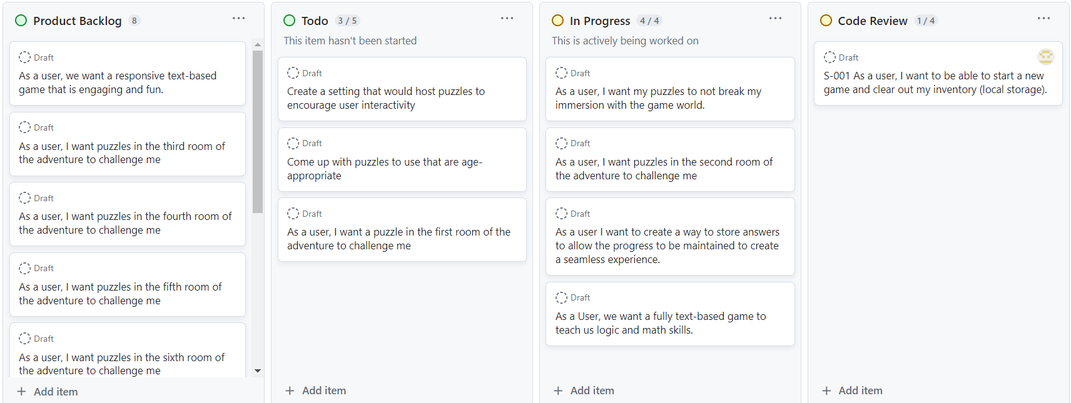
KanBan and Configuration
Ongoing Inspection via Code Review allows issues to be resolved for value maximization.

Slide 4
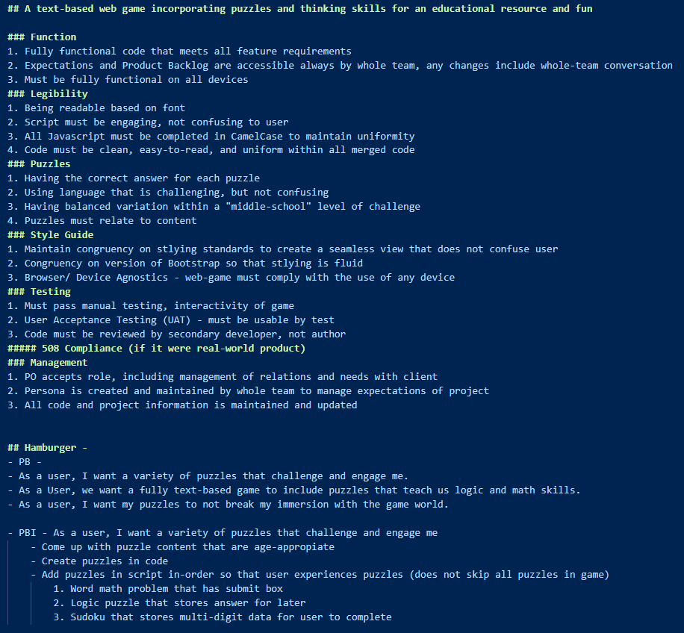
ARCHITECTURE AND DESIGN
3
Definition of Done
Reinforces structure for project.
Software Requirements
Ensures a set list of required traits for each component.
Accomplishments & Deviations
Completed traits that made for a user-centered project.

Slide 5
Text-Based Adventure
Seamless HTML script
Must store inventory based on completed puzzles
Must have a unified CSS file to unify scripts so that experience is seamless
Software Requirements
Ensures a set list of required traits for each component.
Script must be in multiple HTML files
Must have a separate JS file for each room script
Must have puzzles that are seamless with the adventure script
One puzzle must be in each room
Must have an inventory for items
Must have a minimum of seven JS puzzles

Slide 6
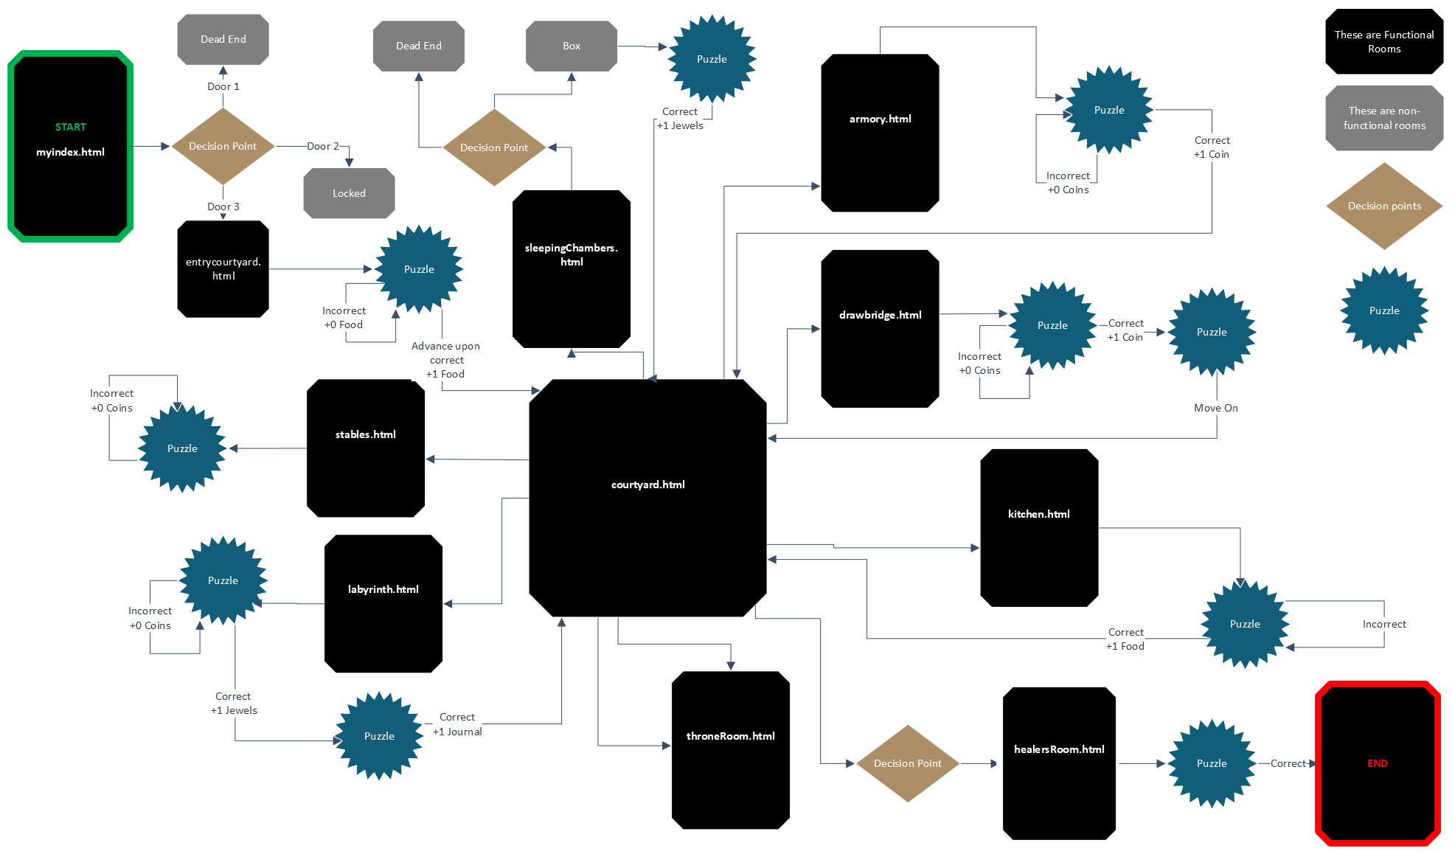

Slide 7
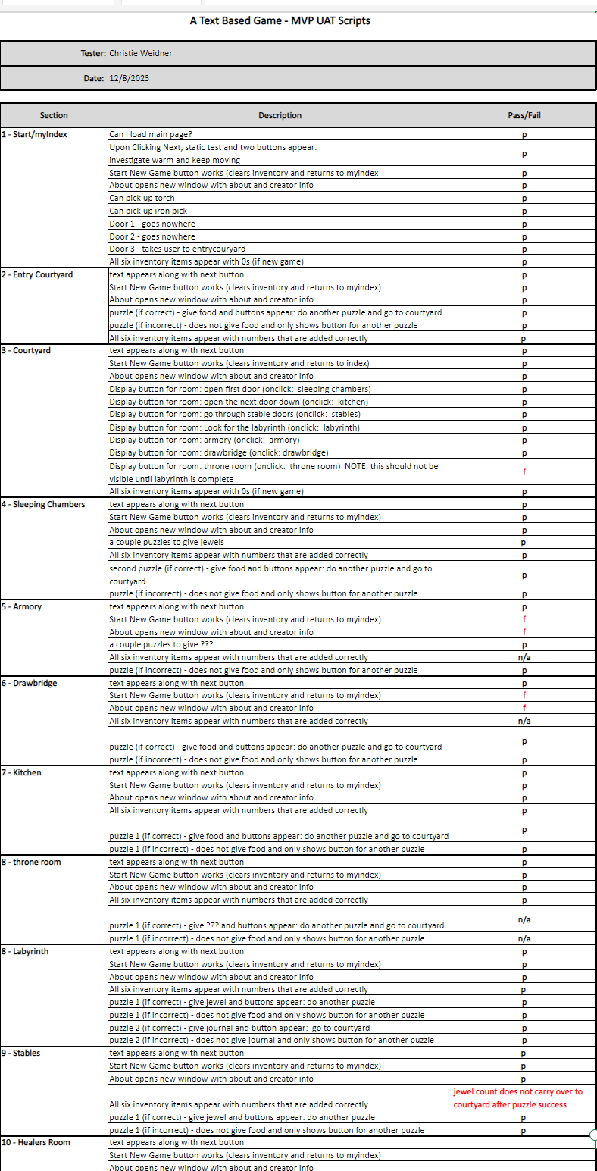
Software Testing
Ensures a fully-functional
deliverable where value is
realized.

Slide 8
Text-Based Adventure
Accomplishments & Deviations
Deviations
Accomplishments
Completed traits that made for a user-centered project.
Deviations allowed for the creation of Increments suitable for user.
Not all rooms required puzzles
Has 9 JS Puzzles total
Local storage in single HTML file
Puzzles seamless with script
Rooms not required for completion
Each puzzle stored in separate JS file
Story altered for seamless adventure
Local storage used for inventory

Slide 9
RISKS AND CHALLENGES
4
RISKS WE FACED | CHALLENGES WE ENCOUNTERED
Scope: Ability to create a game that can be diverse enough to induce challenge in users and developers. | Creativity: Developing scripts, puzzles, and inventory items that can be developed.
Content: Ability to Ideate and Develop content for script and puzzles. | Compatibility: Merging branches together while maintaining unity in code and its functionality.
Performance: Ability to consistently develop puzzles that are engaging for a prospective user aged middle-school. | Complexity: Ability to expand content that is complex without diverting from hamburger method.
Communication: Ability to shift from daily meetings to lesser communication that leads to assumptions. | Scrum: Maintaining strict timeboxes for each developed Increment.

Slide 10
INSIGHTS
5
CodingTEAMS sessions worked really well
Accountability coincided with Transparency
Communicate early and often!
Asking for help speeds the process
Learning from each other made this project more efficient and fun!
Defining what is IN scope vs OUT of scope EARLY is crucial
Maintenance of PB on Kanban helped visualize next steps
Planning ahead +1 Sprint creates Transparency and ease of Implementation
Hamburger balanced ability with timeline
Flowcharts help with project visualization and JS
This is a viable idea with real world applications!!

Slide 11

RESULTS AND DEMO
6
The Healer’s Secret:
A Text Game

Slide 12
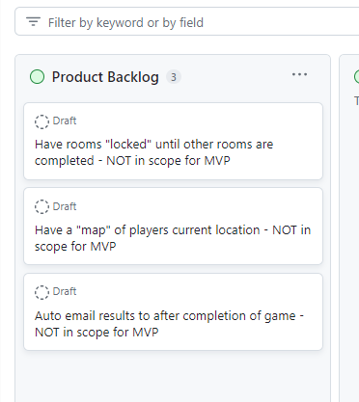
FUTURE WORK
7
Develop content to adapt for different-aged users
MULTI-USER CONTENT
iterating adventure to include more education for different demographics and specializations
EDUCATION
TRACKING ROOM PROGRESS
Creating logic so that
it tracks if you have visited before or need to visit this room - pixel map
ACCESS- ABILITY
ITERATION
Hiding rooms so that they only appear when the journal is found
Real testing with users to test adventure for feedback and iterations

Slide 13

Feedback

